Slide 1
AAA – NCNU Functional Training
Lalitha Kiran Koduri

Slide 2
Introduction to Auto Insurance – Day 1
Policy
A contract of Insurance between the insured and insurer.
Driver
People covered under a policy. A policy can have more than one drivers.
Vehicle
Vehicles covered under a policy. More than one vehicle can be insured under a policy.
Notes:
Policy : A contract of Insurance.
Driver : People covered under a policy.
Vehicle: Vehicles covered under a policy.
Coverages:

Slide 3
Introduction to Auto Insurance (contd) – Day 1
Coverages
Bodily Injury (BI) Pays for injuries caused to other individuals in the event of an accident.
Property Damage (PD) Pays for damage caused to the property of others, incl cars as a result of an accident.
Uninsured motorist/ Underinsured motorist Bodily Injury (UMBI/UIMBI) which covers bodily injury caused by another motorist who doesn't carry liability insurance.
Uninsured motorist property damage (UMPD) covers property damage caused by another motorist who doesn’t carry liability insurance.
Medical Payments (MP) covers medical expenses of the policy holder and any passenger regardless of who is at fault.
Personal Injury protection (PIP) An extension of other coverages which takes care of medical expenses, lost wages and other damages, regardless of who is at fault. Comprehensive (COMP) pays for the repair or replacement of policy owners car in the event of damage not resulting from an accident.
Collision (COLL) pays for the repair or replacement of policy owners car in the event of an accident no matter who caused the accident.

Slide 4
Introduction to Auto Insurance (contd) – Day 1
Discounts
Membership Discounts
Multi policy Discounts (AAA Life Insurance, AAA Motorcycle, AAA Property)
Multi Car Discounts
Loyalty Discounts
Affinity Discounts (AAA Employee)
Smart Driver Good Student
Experience
Defensive Driver
Military Defensive Driver

Slide 5
Introduction to Auto Insurance (contd) – Day 1
Surcharges
Foreign/International License Surcharge (FDL), Out-of-State License Surcharge
Unverifiable Driving Record Surcharge
SR22 Surcharge: Document which provides proof of carrying the minimum auto insurance required by the state. It is typically required of persons convicted of various traffic violations such as DUI.
Limits
A Limit is the maximum amount that an auto insurance company will pay for in the event of an accident.
Deductible
A Deductible is the amount of money which you (the insured) must pay before the insurer's payout begins.

Slide 6
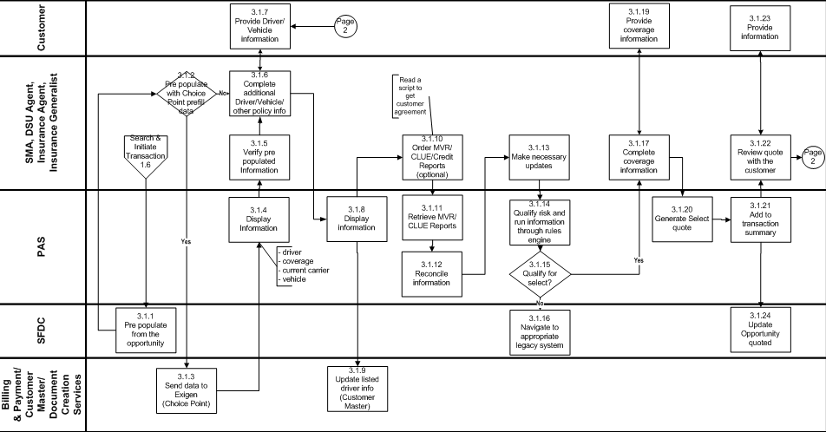
Business Processes: Quote – Day 2

Slide 7
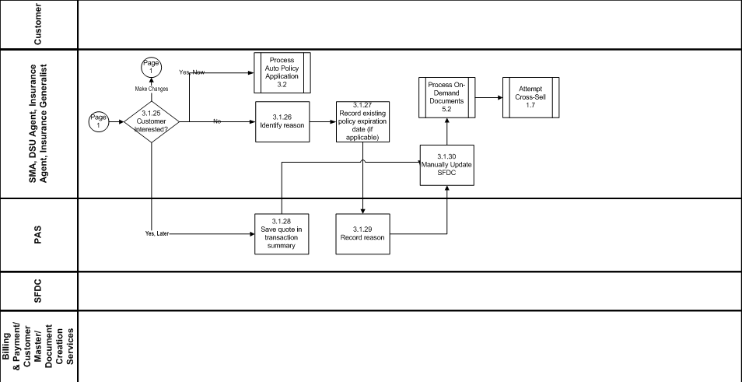
Quote (Contd) – Day 2

Slide 8
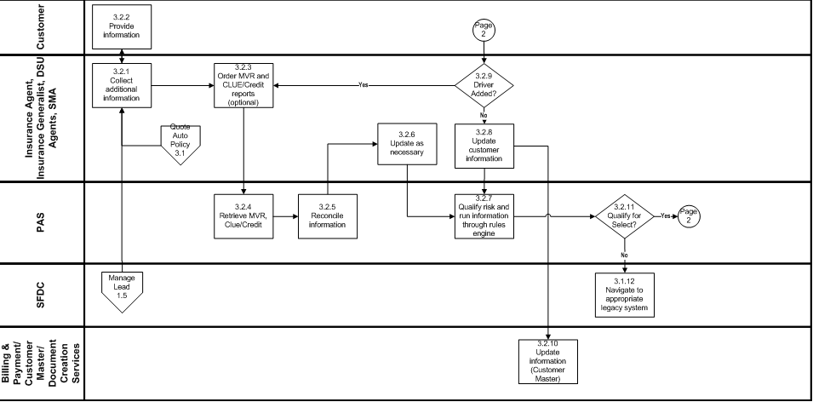
Auto Policy Application – Day 2

Slide 9
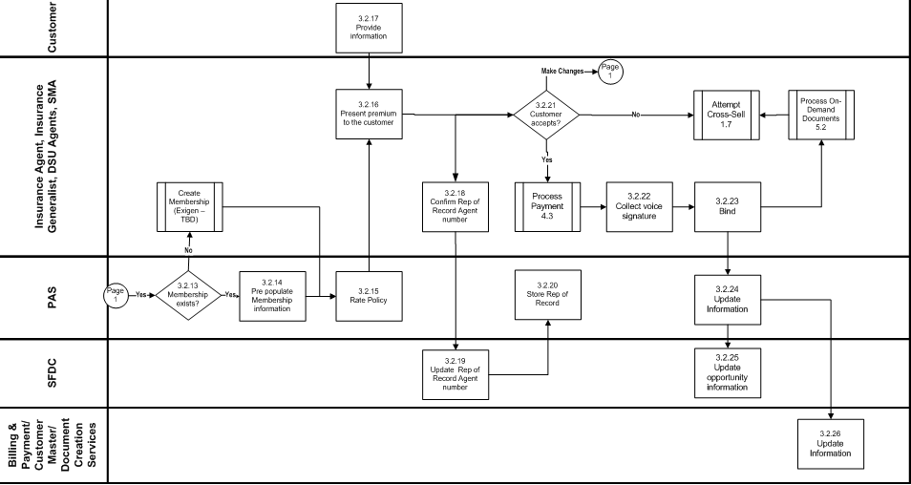
Auto Policy Application (Contd) – Day 2

Slide 10
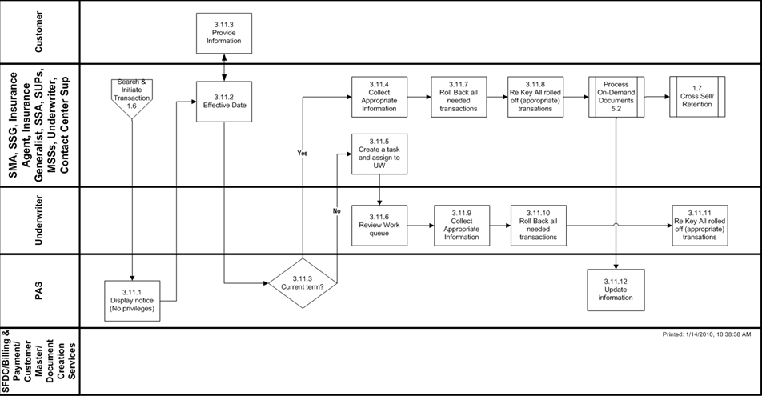
Out Of Sequence Endorsement – Day 2

Slide 11
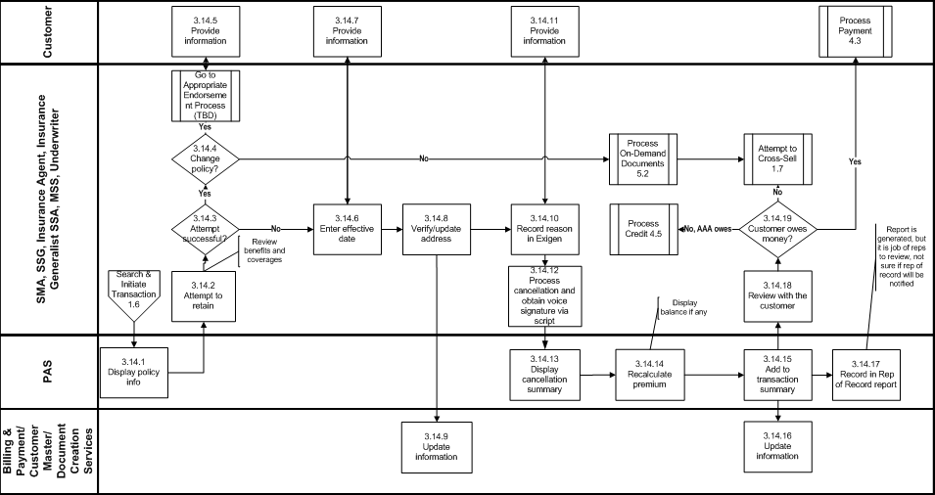
Cancel Policy (Customer Initiated) – Day 3

Slide 12
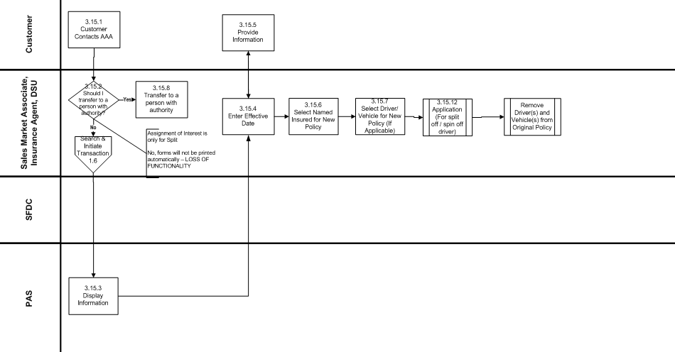
Split / Spin Policy – Day 3

Slide 13
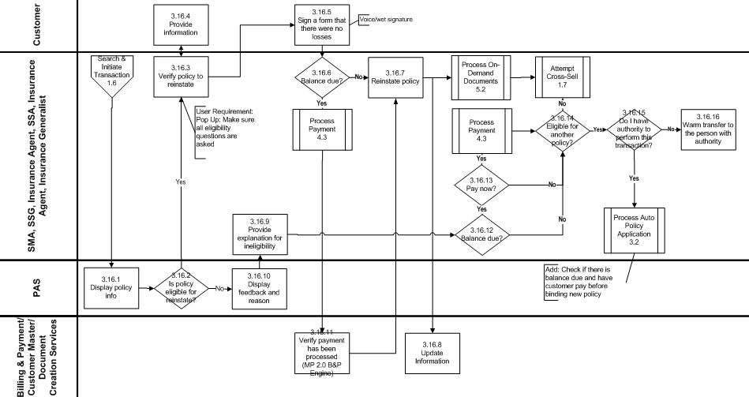
Reinstate Policy – Day 3
Policy is put back in force by the company after it had cancelled for non payment of premium. NO coverage during the time from when the policy cancelled, to when it is reinstated.

Slide 14
Documents we deal with – Day 4
The documents contain multiple deliverables, categorized by Business or Design ownership. These deliverables contain key components which define the Business and Design requirements across all states.
Deliverable Name | Key Components |  | Delivery Ownership
Product Specifications | Coverages, Limits, Deductibles Cancelation Reasons Rating Algorithm/Pricing Rules | Driver Types Chargeability Diagram Point Assignment Table | Business
Product Rules and State Deltas | Product Rules Underwriting Rules | Workflow Rules Task Generation/Routing Rules | Business
Product Lookups | Valid Value lists Translation Values |  | Business
Forms Library Requirements | Form Generation/Attachment Criteria Form Content – Variable/Static |  | Business
Role Based Functional Access | Role based system access Group Authority |  | Business
Business Rules | EARs MVR Risk Alert |  | Business
User Stories | User interaction/ business trigger System Responses |  | Design
Validation Criteria | Rules/Validations/Edits UI Interaction/Response |  | Design
Wireframe | Page and Data Element definition Control/Action/Response |  | Design
Testing Package | Business Scenarios System Functions |  | Testing

Slide 15
What do we do? – Day 4
Analyze & Identify Deltas
Product Specification
Rating Algorithm
Map
Map the themes – Subthemes in EKM to the deltas.
Update/Create
User Stories
Validation Criteria
Product Lookup
UW Rules and Tasks
Forms
Reviews
Other Activities
EKM/Agenda
RTC, QC
Trackers, Actuals and Backlog Updation
TP Reviews
Offshore Peer reviews
Onshore Peer Reviews
Stakeholder Reviews

Slide 16
Exercise 1 – Identification of Delta
Product Specification
UW Rules
Lookup
Rating Algorithm
Identify deltas for the state of Pennsylvania, Maryland and Utah

Slide 17
Exercise 2 – Identification of impacted themes
Deltas :
Discounts & Surcharges - Motorcycle discount
Processing Guidelines – UW Cancellation
Coverages – Defensive driver discount
UW Rule –
Rating –
Integration –

Slide 18
Exercise 3 – Updation of US/VC
Looking at the assessments for each of the deltas, update the US/VC for impacted themes.
Discounts & Surcharges - Motorcycle discount
Processing Guidelines – UW Cancellation
Coverages – Defensive driver discount
UW Rule –
Rating –
Integration –

Slide 19
Questions ?

